Slide 1
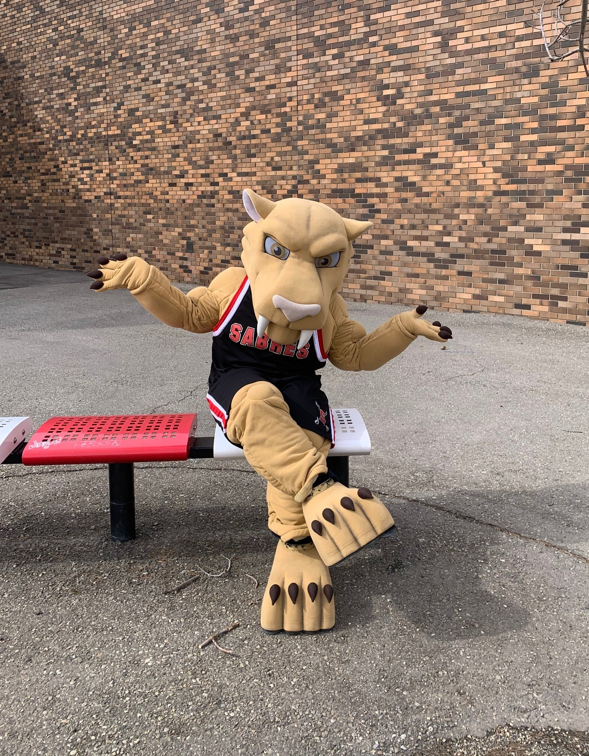
Salisbury Composite High School
Football Presentation

Slide 2
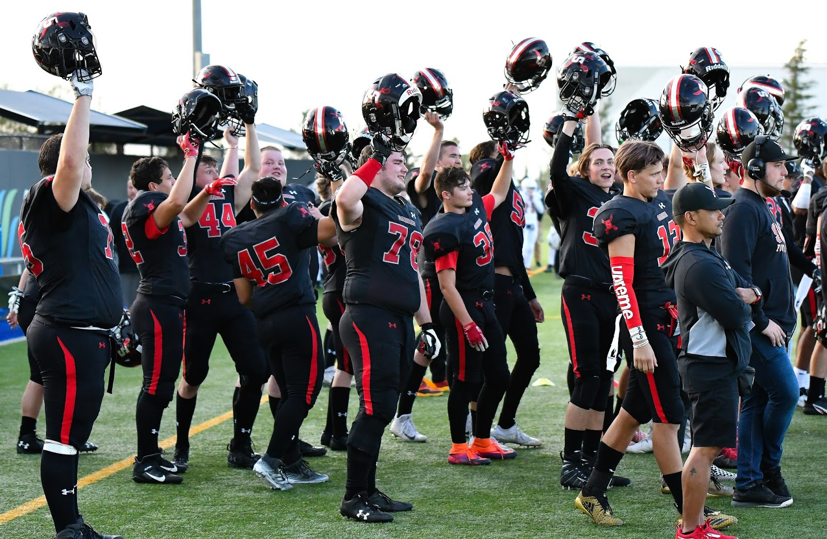
SAL FOOTBALL
BACKGROUND & PHILOSOPHY
THE SALISBURY SABRES COMPETE ANNUALLY IN THE METRO EDMONTON DIVISION ONE CARR CONFERENCE. THIS LEAGUE INCLUDES SCHOOLS FROM SHERWOOD PARK, EDMONTON, ST. ALBERT, & SPRUCE GROVE. FOR OVER 40 YEARS WE HAVE STRIVED TO PRODUCE ATHLETES FOR THE NEXT LEVEL (CJFL & U-SPORT) AND MOST IMPORTANTLY, PRODUCE GREAT CITIZENS FOR OUR SOCIETY.
ALUMNI BURSARY
ONE STEP SAL FOOTBALL TAKES TO PRODUCE GREAT CITIZENS IS THROUGH OUR ALUMNI BURSARY PROGRAM. EACH YEAR, WE OFFER 4-5 BURSARIES OF $750.00 TO FORMER PLAYERS TO ASSIST THEM IN THEIR POST SECONDARY ENDEAVOURS.
RED & BLACK BOOSTER CLUB
REGISTERED NOT-FOR-PROFIT ORGANIZATION MADE UP OF PARENT VOLUNTEERS THAT ARE RESPONSIBLE FOR MANAGING FUNDRAISING/EVENTS AND DELIVERING FINANCIAL ACCOUNTABILITY.
2 TEAMS 1 PROGRAM
salfootball.com
#SABRENATION #SABREPRIDE #GOBIGRED
@salcompfootball

Slide 3
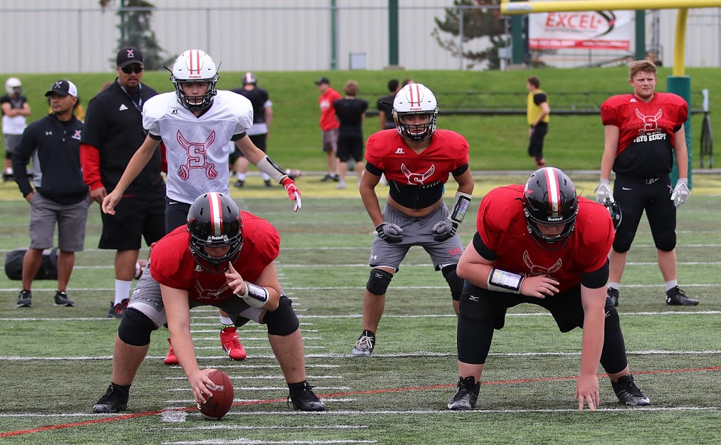
SAL FOOTBALL
TENTATIVE DATES 2021
SPRING CAMP | June 1 –11, 2021.
MAIN CAMP | AUGUST 16 (SENIOR) AUGUST 24 (JUNIOR)
JAMBOREE | DATE TBD
SEASON START | DATE TBD
TEAM FEES 2021 | $575.00
SINGLE PAYMENT | E-TRANSFER, CHEQUE, DEBIT, VISA, MASTERCARD
MULTIPLE PAYMENT | 1. $200 CHEQUE (June 1st, 2021) 2. $200 CHEQUE (July 1, 2021) 3. $175 CHEQUE (August 1, 2021)
EQUIPMENT DEPOSIT | $400.00
POST DATED CHEQUE (NOVEMBER 30, 2021)
CASHED IF EQUIPMENT IS MISSING OR NOT RETURNED
SPRING CAMP | $60
REQUIRED TO PARTICIPATE IN CAMP
2 TEAMS 1 PROGRAM
salfootball.com
#SABRENATION #SABREPRIDE #GOBIGRED
@salcompfootball

Slide 4
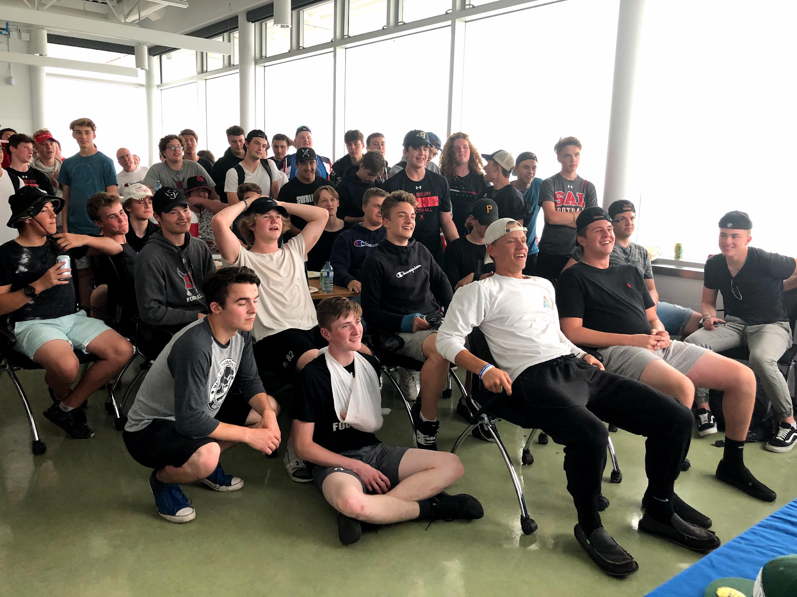
SAL FOOTBALL
TEAM BUILDING ACTIVITIES
KICK OFF BBQ | FAMILY BBQ AT SPRING CAMP WHERE SABRE FAMILIES CAN MEET ONE ANOTHER.
TEAM MEAL | WEEKLY MEAL WHERE BOTH TEAMS SIT DOWN TOGETHER AND SHARE A MEAL.
GYM NIGHTS | FOOTBALL SPECIFIC GYM NIGHTS ENDED WITH SOME GAMES (DODGEBALL, BASKETBALL, COMPETITIONS, ETC.)
EXHIBITION GAMES | SENIOR TEAM TRAVELS TO COMPETE AGAINST NON-METRO EDMONTON TEAMS (LETHBRIDGE, RAYMOND, LLOYDMINSTER)
FAQ
PRACTICES | MONDAY-FRIDAY (4:30-6:30 @ SAL)
GAMES | SENIOR (THURSDAY/FRIDAY) & JUNIOR (TUESDAY/WEDNESDAY)
TRANSPORTATION | BOTH TEAMS ARE BUSSED TO ALL GAMES
2 TEAMS 1 PROGRAM
salfootball.com
#SABRENATION #SABREPRIDE #GOBIGRED
@salcompfootball

Slide 5
QUESTIONS? CONTACT…
CAM FRASER | HEAD FOOTBALL COACH
cam.fraser@eips.ca

Slide 6
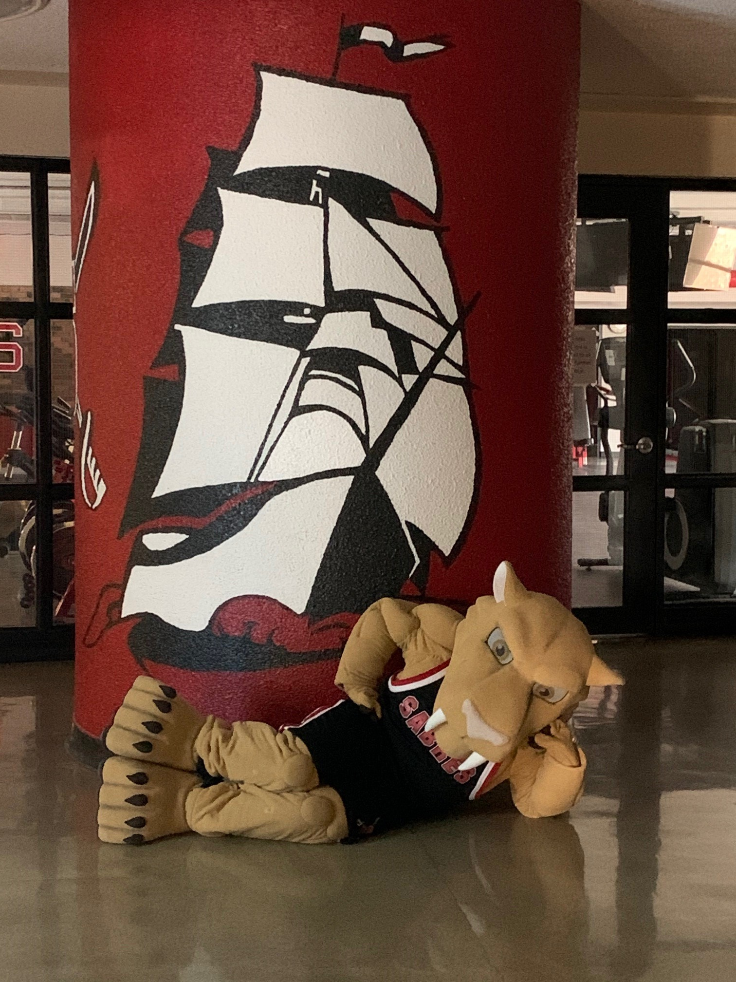
Salisbury Composite High School
Open House Presentations
Thank you for joining us!
The next presentation will begin shortly.

